Slide 1

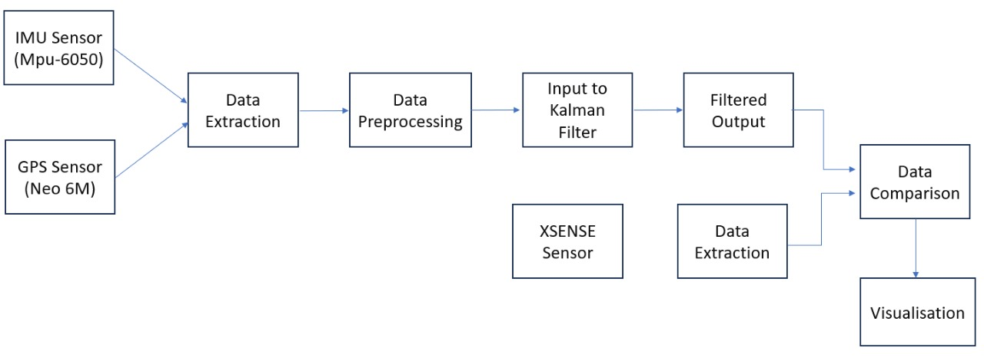
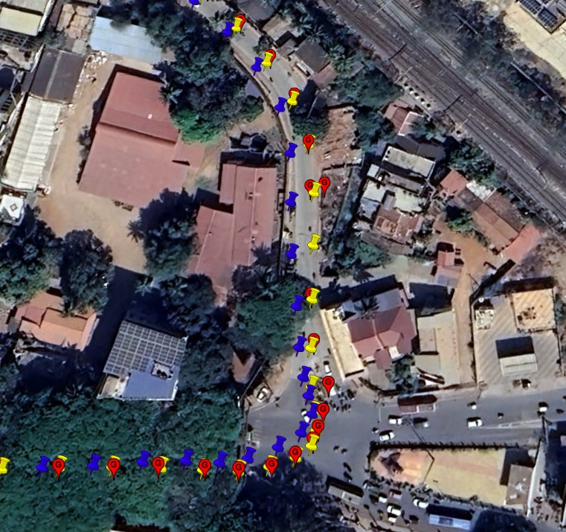
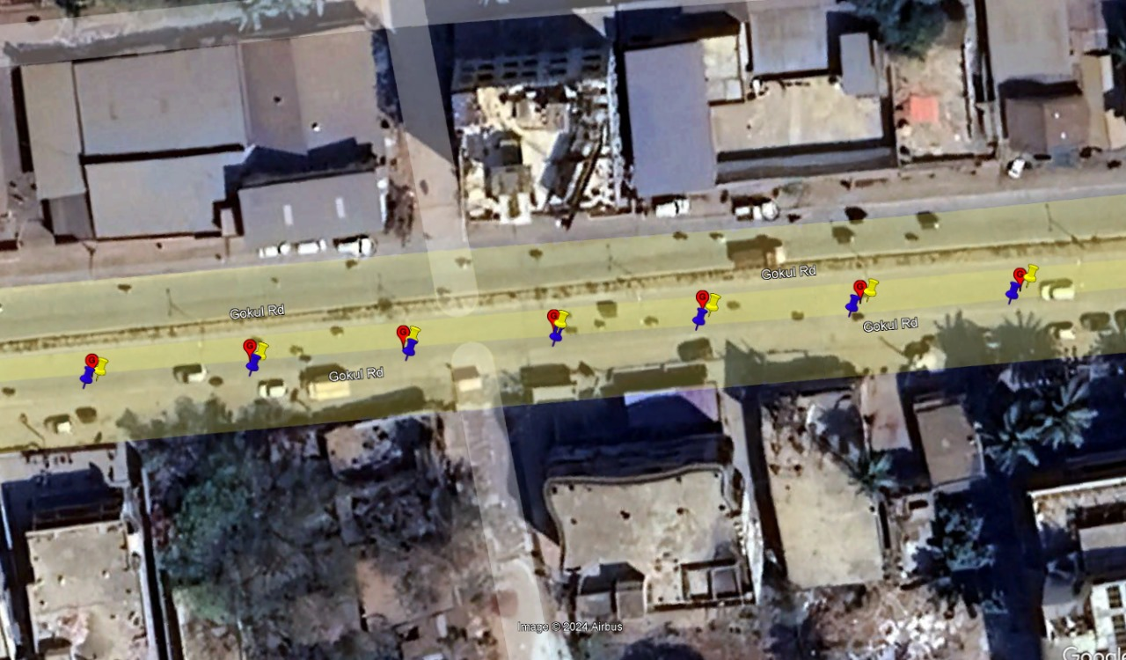
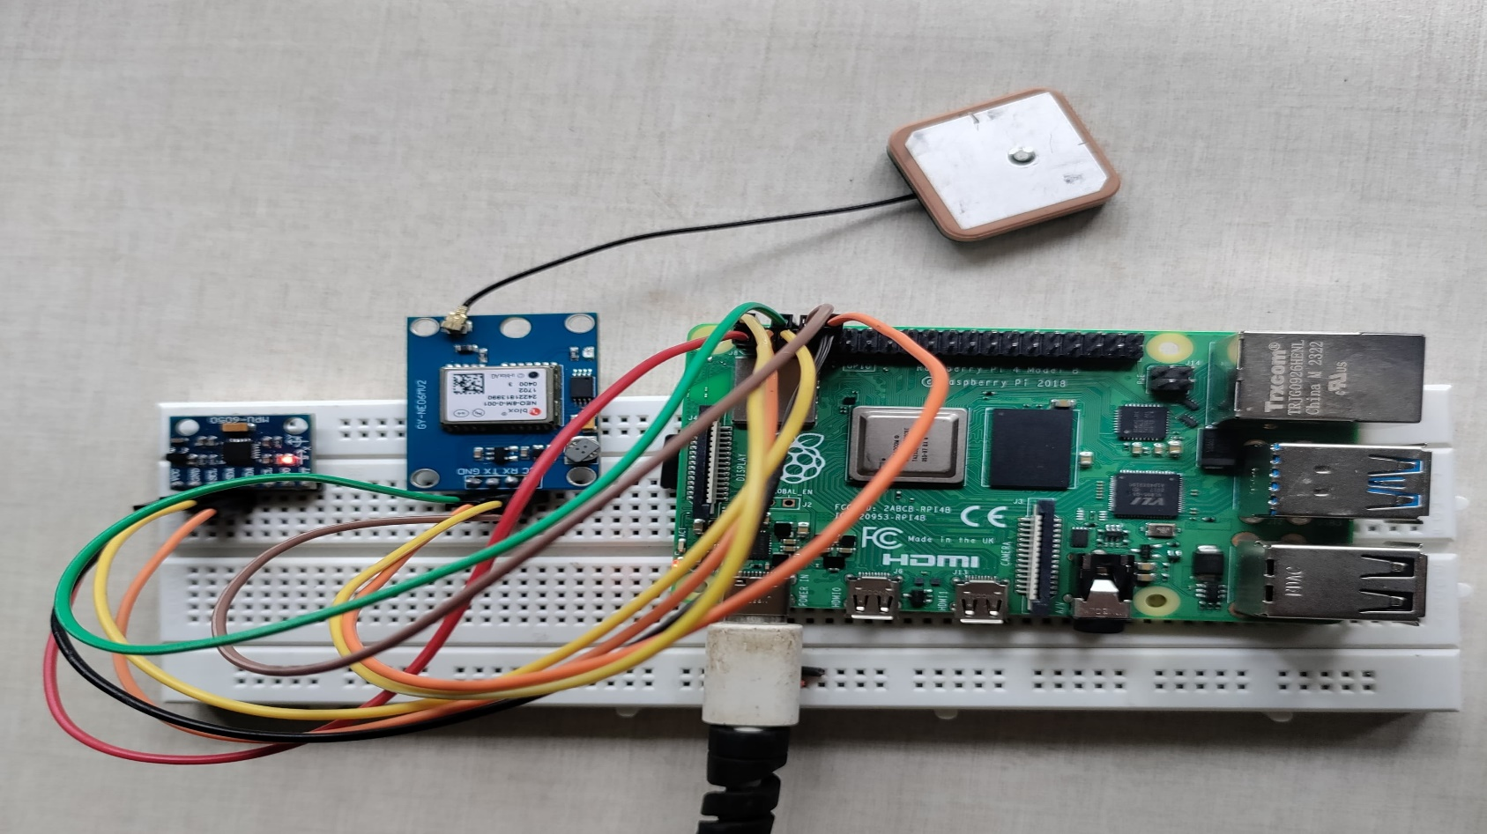
Project Title: Sensor Fusion Based Ego Localization using Kalman Filter for Autonomous Vehicles
Team Members: Vijay Pattar(USN:01FE21BEC370), Prajwal Gouda J(USN:01FE21BEC187), Nishchit Mogali(USN:01FE21BEC198), Nandan Illur(USN:01FE21BEI058), Madhushree Hegde(USN:01FE21BEI040).
Guide: Prof.Akash Kulkarni
Need statement
System Block Diagram
SDG Connect
A Kalman Filter-based sensor fusion approach is needed to improve ego localization accuracy in autonomous vehicles, driving innovation and supporting sustainable urban mobility.
The project supports SDG 9 by advancing autonomous driving technologies through improved ego localization accuracy, driving innovation in transport systems, and enhancing infrastructure. It aligns with SDG 11 by enabling precise navigation for autonomous vehicles in urban areas, promoting sustainable transport, inclusive urban planning, and reduced environmental impact.
..
Literature Survey
Sensor Fusion Based Localization using ​Schmidt Kalman Filter: Autonomous Vehicle​​Authors: Subrahmanya Gunaga, Akash Kulkarni, Nalini Iyer ​
Adaptive Kalman filtering based navigation: An IMU/GPS integration approach
Results
System Setup
Problem statement
Sensor Fusion Based Ego Localization using Kalman Filter for Autonomous Vehicles​
Objective
Conclusion and Future Scope
Objective Fusion of GPS(NEO6m) and IMU(MPU6050) sensor​​Reducing error in the Localization​​​​​​
The project enhances ego localization accuracy, advancing autonomous driving technologies and supporting sustainable urban mobility by enabling precise navigation for autonomous vehicles and promoting efficient, eco-friendly transportation solutions.
Future scope includes integrating advanced sensors like LIDAR, enhancing cloud-based systems for real-time data processing, and expanding applications to various urban scenarios.
Challenges and Considerations
Requirements
Achieve accurate synchronization of data from different sensors to enable effective sensor fusion
Optimize the algorithm for efficient execution on the Raspberry Pi, balancing data acquisition rates and processing capabilities.
Hardware: Raspberry pi 4b, Neo 6M, Mpu 6050, 3.5 inch RPI display
Real vnc viewer , Raspberry pi imager
School Of Electronics and Communication Engineering Team No: 12 Minor Project I -2023-24

